Slide 1
RASD MyTaxiService
Paramithiotti A.
Rompani A.
Zoia L.

Slide 2
What we did at the beginning
We read the text exhaustively:
What is the project about?
What are the tasks?
What are we required to do?

Slide 3
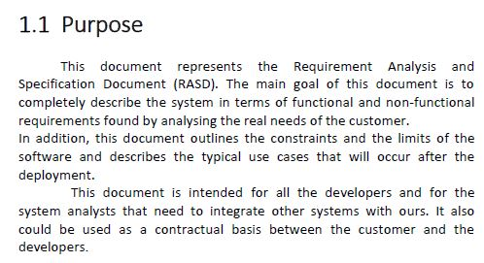

Slide 4
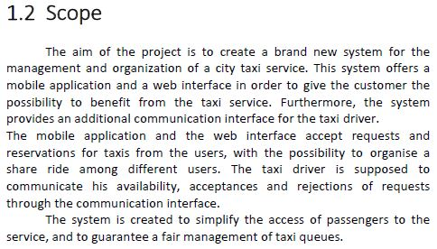

Slide 5
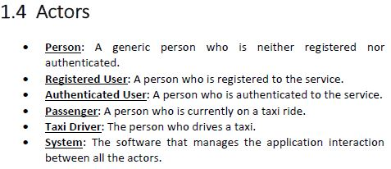
Actors definition

Slide 6
Hierarchy
Person
Taxi driver
Registered user
In order to identify the different levels of users and to isolate the functionalities between them, we introduced different kinds of users.
Authenticated user
Passenger

Slide 7
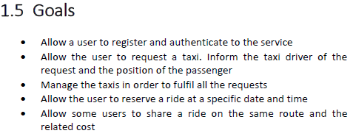
Goals Definition

Slide 8
Goals Definition
What we thought was necessary:
Registration
Authentication
What we guessed from the text :
Reservation
Normal and Shared ride
Taxi Management

Slide 9
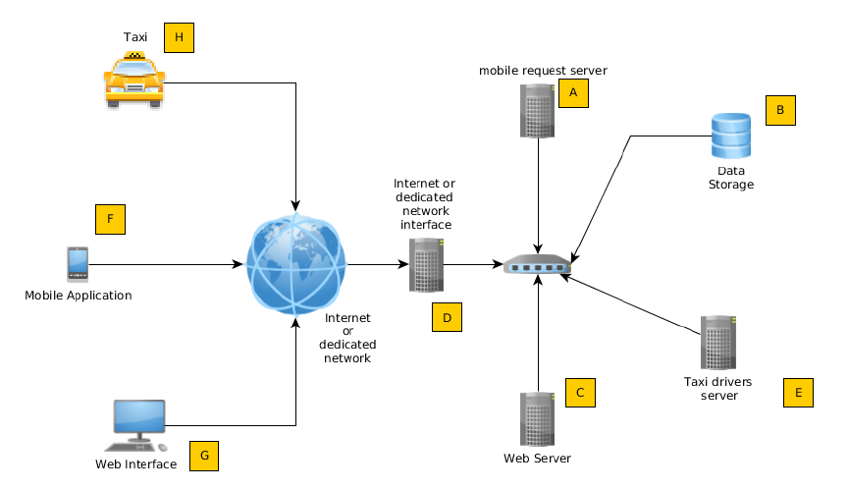
System Interfaces

Slide 10
Constraints
Only authenticated users allowed
Authentication for the taxi driver
Reachability of the system
Reliability of the system
No simultaneous authentications of the same user
Fair management of the taxi queues

Slide 11
Assumptions and Dependencies
Multi platform application
HTML 5 compliance
Total number of taxies
Minimum number of taxies in total
Maximum number of passengers per taxi

Slide 12
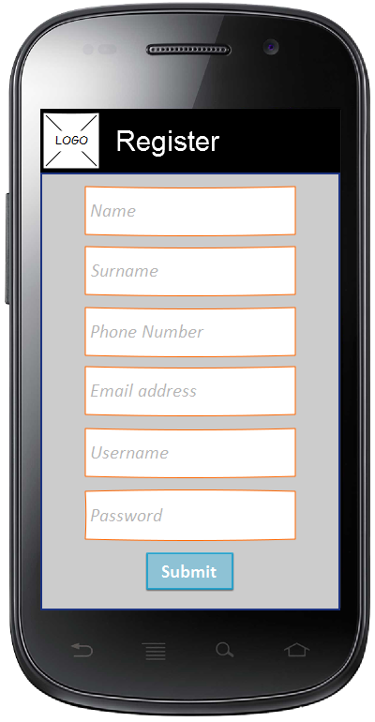
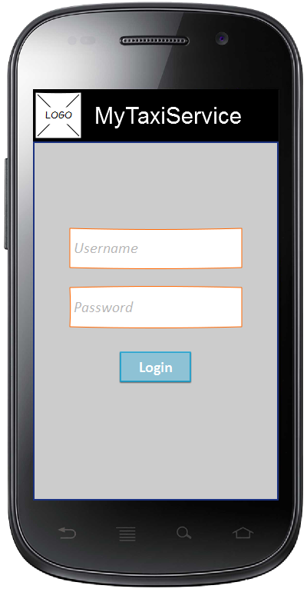
Specific Requirements

Slide 13
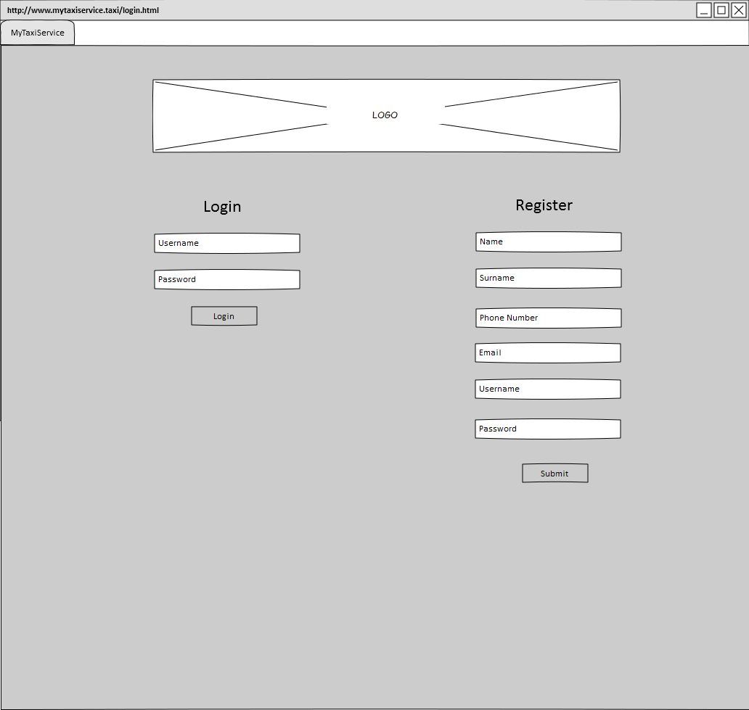
Specific Requirements

Slide 14
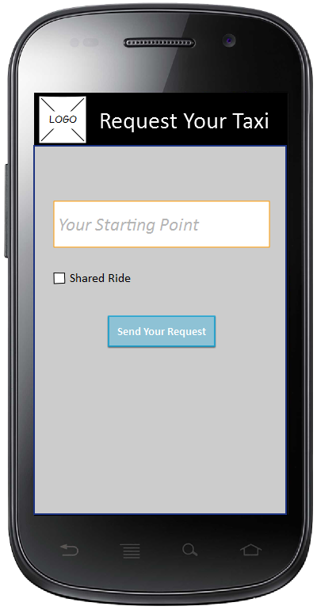
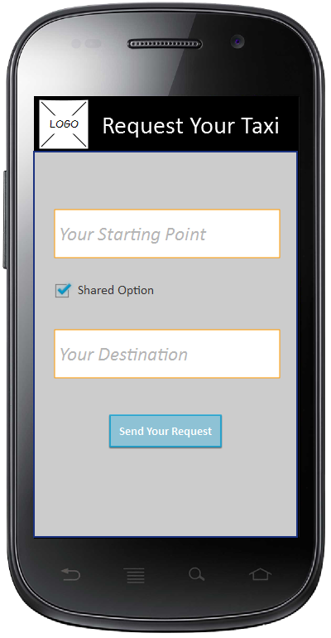
Specific Requirements

Slide 15
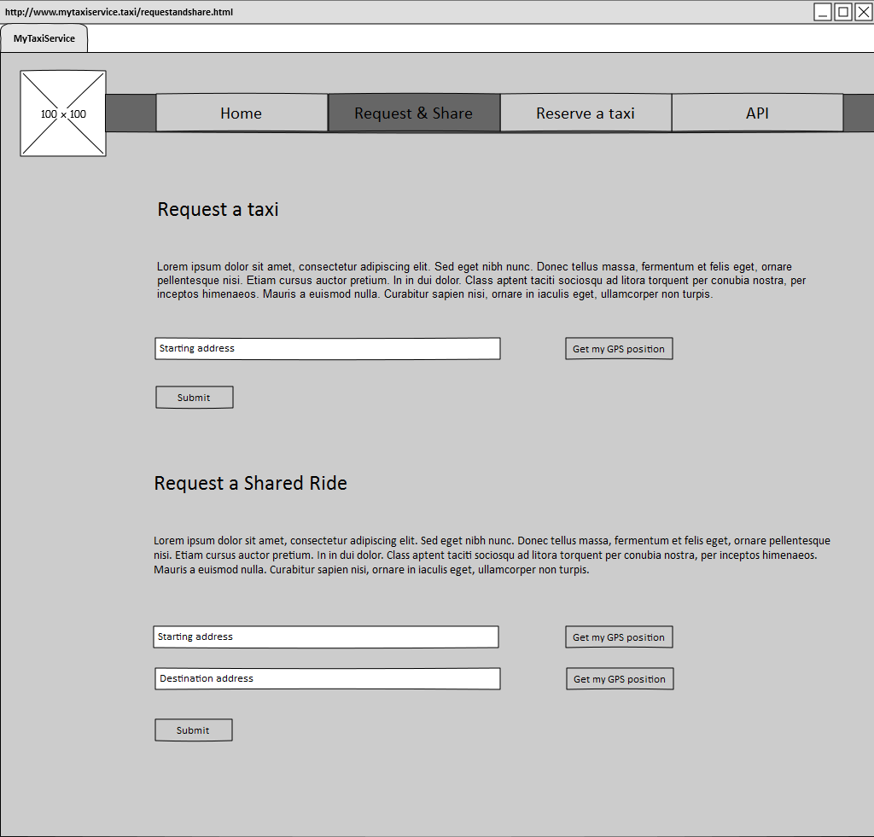
Specific Requirements

Slide 16
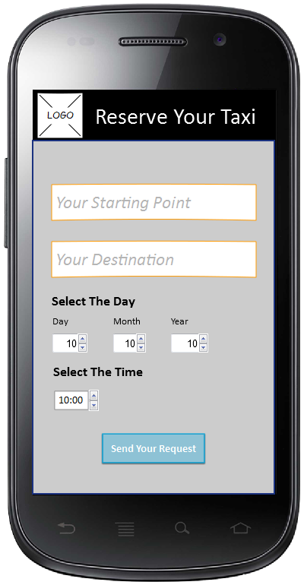
Specific Requirements

Slide 17
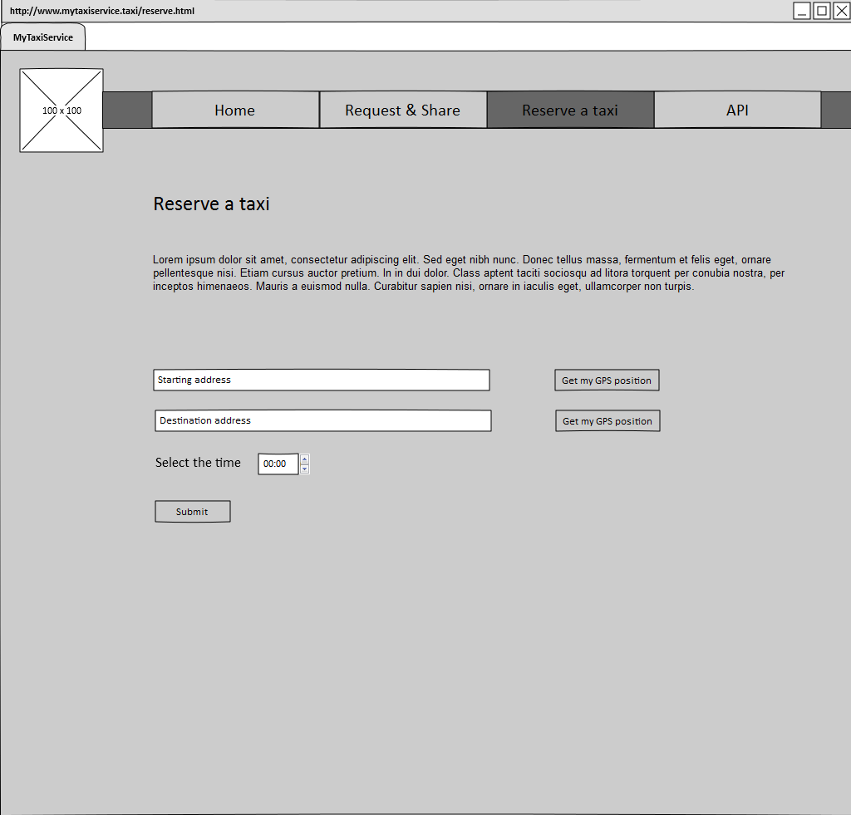
Specific Requirements

Slide 18
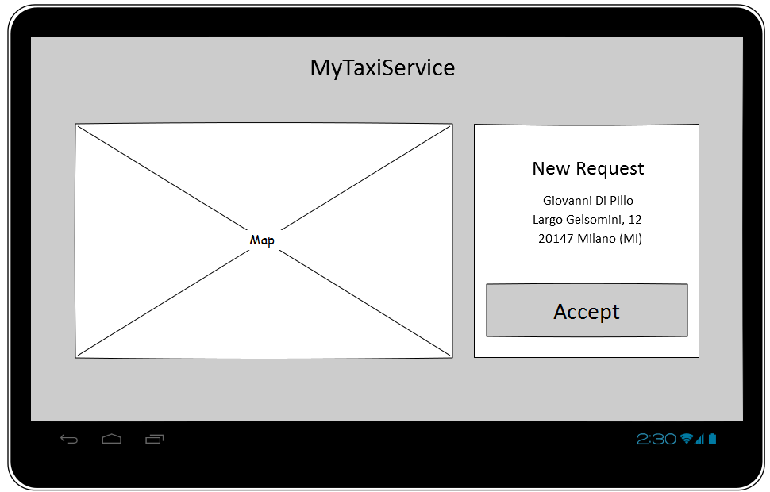
Specific Requirements

Slide 19
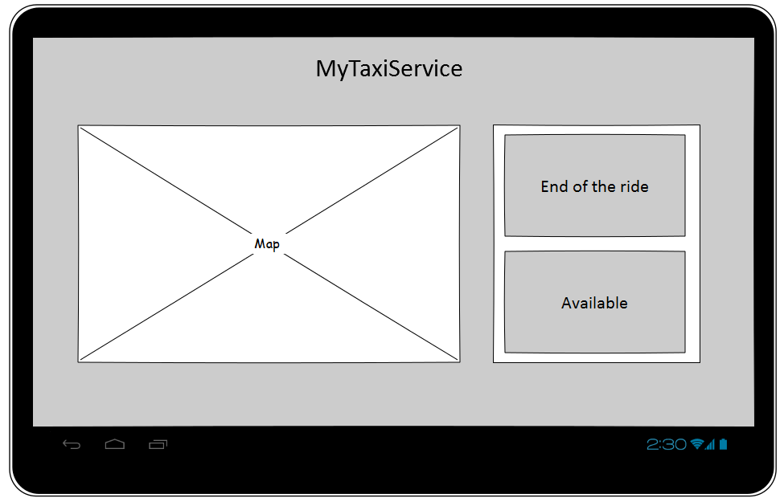
Specific Requirements

Slide 20
Functional Requirements
We analyzed every goal and we found out the most important requirements and domain assumptions for each of them

Slide 21
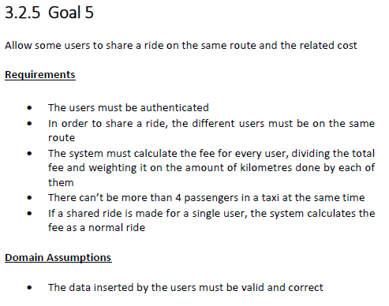
Functional Requirements

Slide 22
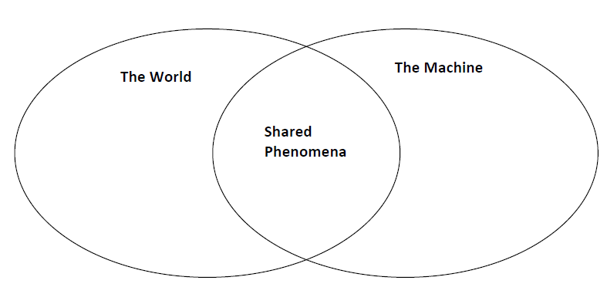
M. Jackson & P. Zave model
We used the Jackson and Zave’s approach to divide the domain in three zones

Slide 23
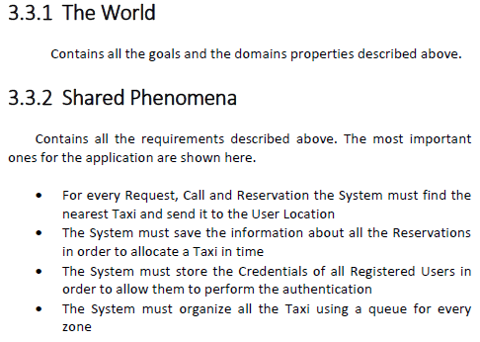
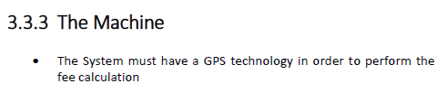
M. Jackson & P. Zave model

Slide 24
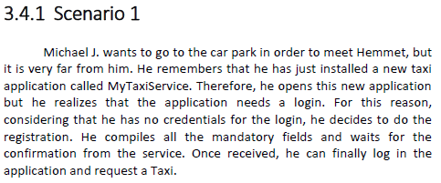
Scenarios
We created some possible scenarios that show some of the uses of our application

Slide 25
Use Cases
Using the scenarios we extrapolated the use case in which we divided our application.
Then we analyzed every use case in details, identifying:
Actors
Goal
Input condition
Event flow
Exit Condition
Exceptions
Special Requirements

Slide 26
Use Cases
Use case name
Request a taxi
Actors
System
Taxi driver
Authenticated User
Goal
Allow the user to request a taxi. inform the taxi driver of the request and the position of the passenger
Input condition
Null
Event flow
The authenticated user fills in the forms in the web application or the mobile app with the address where he wants the taxi to be sent
The system forwards the request to the first taxi in the queue of the area where the passenger is
The taxi driver confirms the request using the mobile app
The system informs the authenticated user about the code of the incoming taxi and the waiting time
The taxi gets to the authenticated user

Slide 27
Use Cases
Output condition
The authenticated user gets in the taxi
Exceptions
If the authenticated user gives an invalid address, the system shows an error message and asks for a new address
If there isn’t any free taxi in the area where the passenger is, the system selects the first taxi from the nearest area
If there isn’t any free taxi at all, the system doesn’t allow the request and shows an error message
If the taxi driver doesn’t confirm the request, the system forwards the request to another taxi driver
If the taxi doesn’t manage to get to the passenger (on time/at all), the system informs the passenger, who must call another taxi
Special Requirements
The city is already divided into Taxi Zones (approximately 2 km² each)
For each zone there is a queue of taxi (it can be empty if there aren’t any taxies in its zone)
Every Taxi and taxi Driver must have an identification code

Slide 28
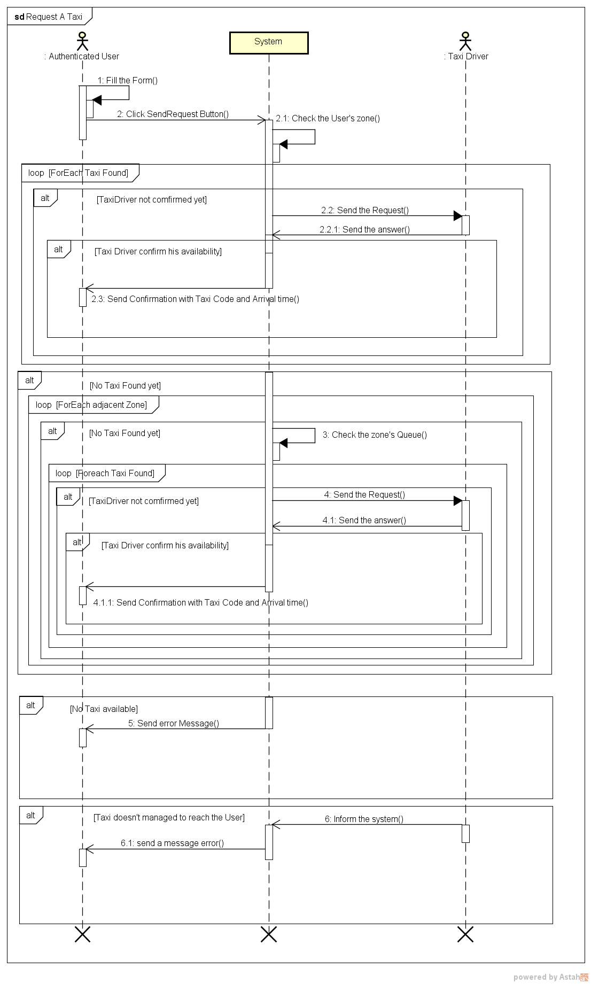
Sequence Diagram

Slide 29
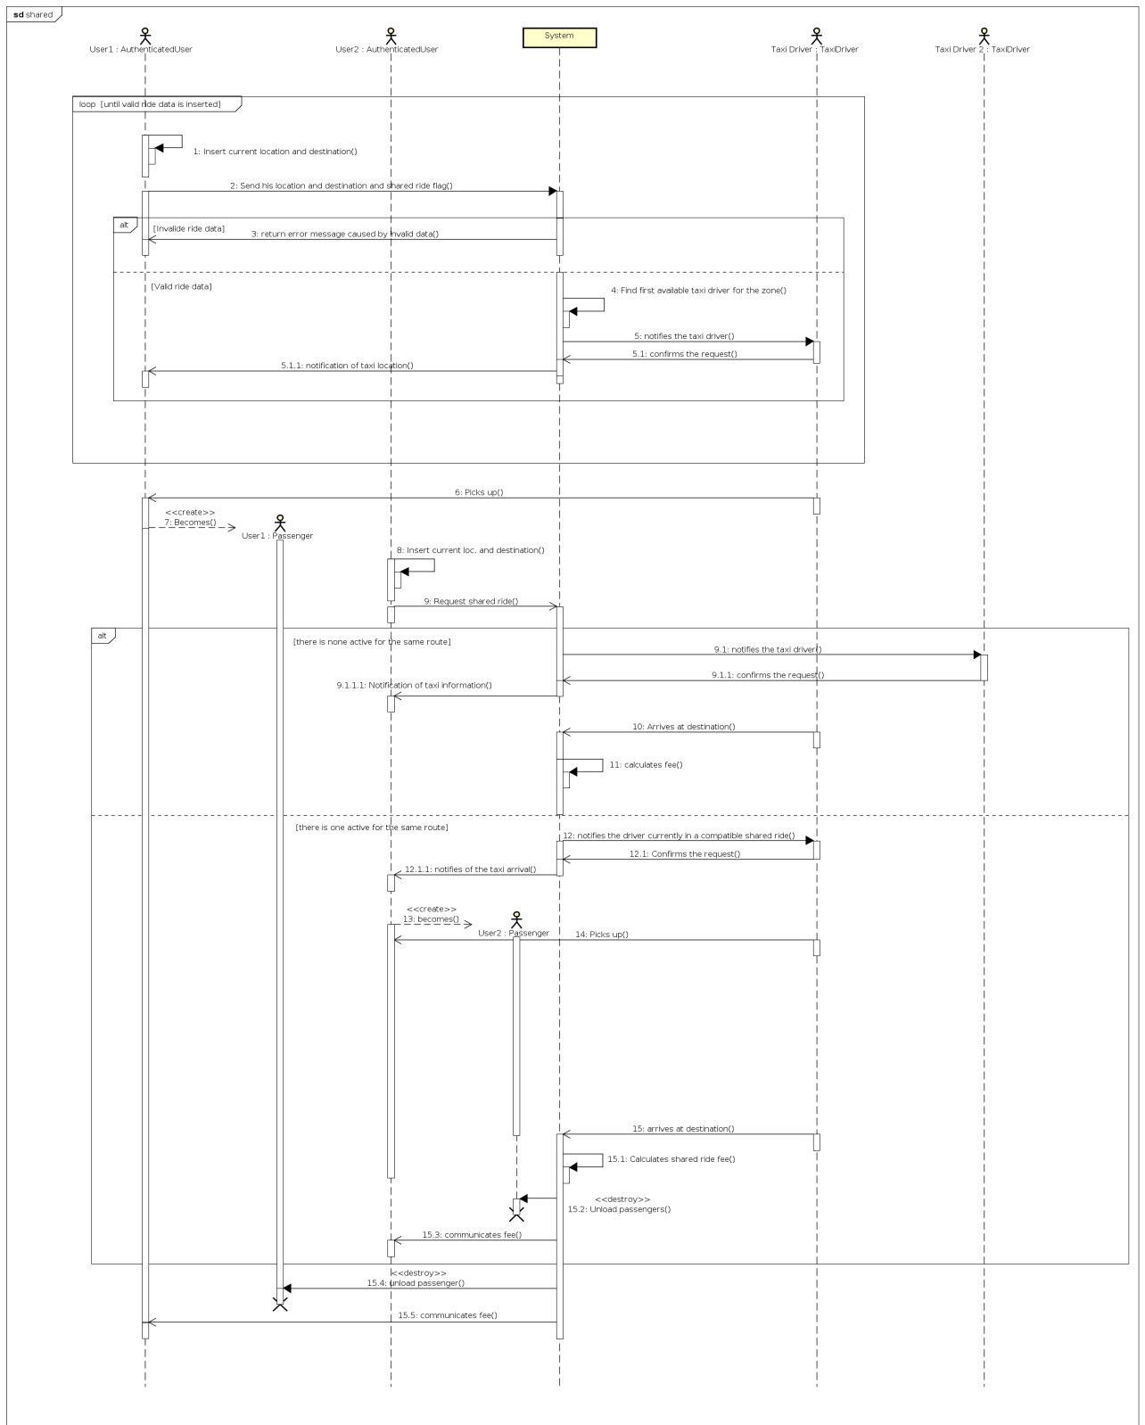
Sequence Diagram

Slide 30
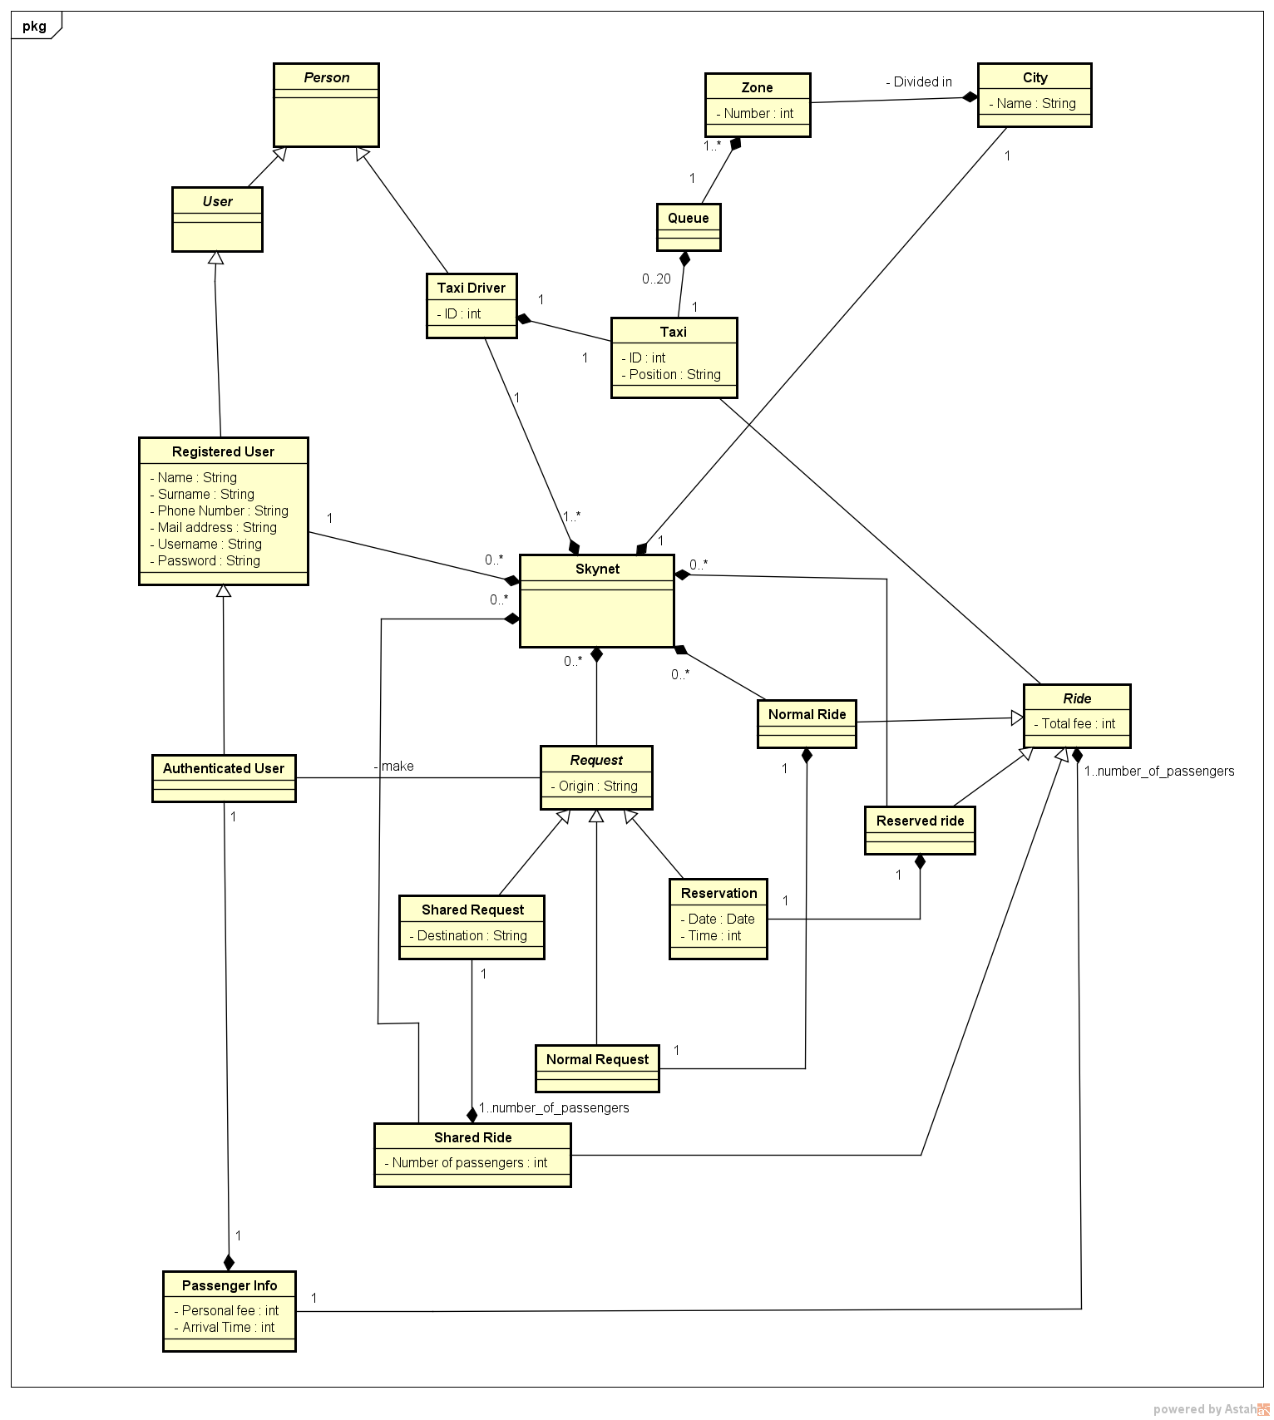
Class Diagram

Slide 31
Nonfunctional Requirements
We defined the nonfunctional requirements for the system divided in:
Performance Requirements
Logical Database Requirements
Design Constraints
Standard Compliance
Software System Attributes (Availability, Reliability, Maintainability, Portability, Security)

Slide 32
Appendix
We modeled the basic structure and logic of our system with Alloy using the use cases:
We modeled every class into a signature
We created the constraints and the relations into facts
We modeled the predicates to show the working of our model
We made assertions to verify the invariant constraints
Finally we made a world from the code using the tool

Slide 33
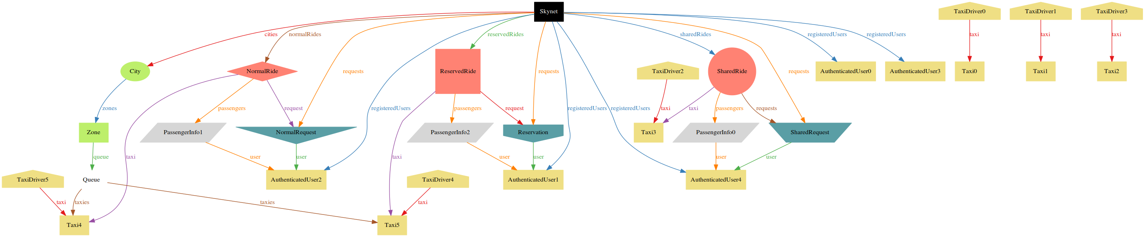
Appendix

